Slide 1
Meta Data & Graph DB
Team 2 Week 8, March 01, 2023
Team Members:
Shanmukh Sanka
Rohit Anumolu
Deepika Kumar
Farzana Chowdhury Shampa

Slide 2




Agenda
Data Dictionary
Synthetic Data Generation
Graphs
Challenges

Slide 3
Desired Data Dictionary
Attributes | Constraints | Description
Customer ID |  | Unique Identification
LOB Code | String of Char | Retail or Commercial
Product Name |  | Home loan, Personal loan, Real-estate loan, Mortgage, Car loan
Customer Type |  | Retail or Commercial
Age | 18 - 80 | Age of the customer
Annual Income | 46000 - 98000 | Annual income of the customer
Missed Payments |  | No. of payments missed by the customer.
Delinquent Days | 30/60/90 | Max delinquent of customer from all loans.
Penalty Fees |  | Any lifetime penalty applied to the account
Probability of Default |  | Denotes the probability the customer will default. Loans would not be issued if this is high.
DTI | <50% | Debt to Income ratio
On Time Payment |  | No. of ontime payments made by the customer
Bullet Flag | 1 or 0 | Denotes if the client can pay all the current balance by the end of the term as a single payment.
Inactive Flag | 1 or 0 | If a deposit account is no longer in use.
Total Reachouts |  | Captures the total number of marketing campaigns run for this customer.
Successful reachouts |  | Captures the successful campaigns of all the reachouts.
Risk Rating | 1-9 | Assign how likely the client is to default.
Primary credit score | 300-850 | Primary Credit Score of the customer. Fix it to be one of Equifax or Experian or TransUnion
Total credit accounts |  | No. of credit account the customer has overall. Truist + External

Slide 4
Synthetic data generation
Most of the data we produced for analysis was a combination of rule-based and random sampling.
Based on the age, we generated the annual income of each customer.
Delinquent days are generated randomly between 30,60 and 90 for each customer.
Probability of default is calculated by assigning weights randomly on primary credit score, missed payments, DTI and delinquent days.
Campaign names are generated randomly by clubbing each list of values.

Slide 5
Challenges during synthetic data generation and graph creation
Identifying the correlation among the attributes
Analyzing the market research for the attributes based on each constraints
Applying rule-based techniques on fields while generating the synthetic data
Identifying the insights on which we might focus to generate graphs

Slide 6
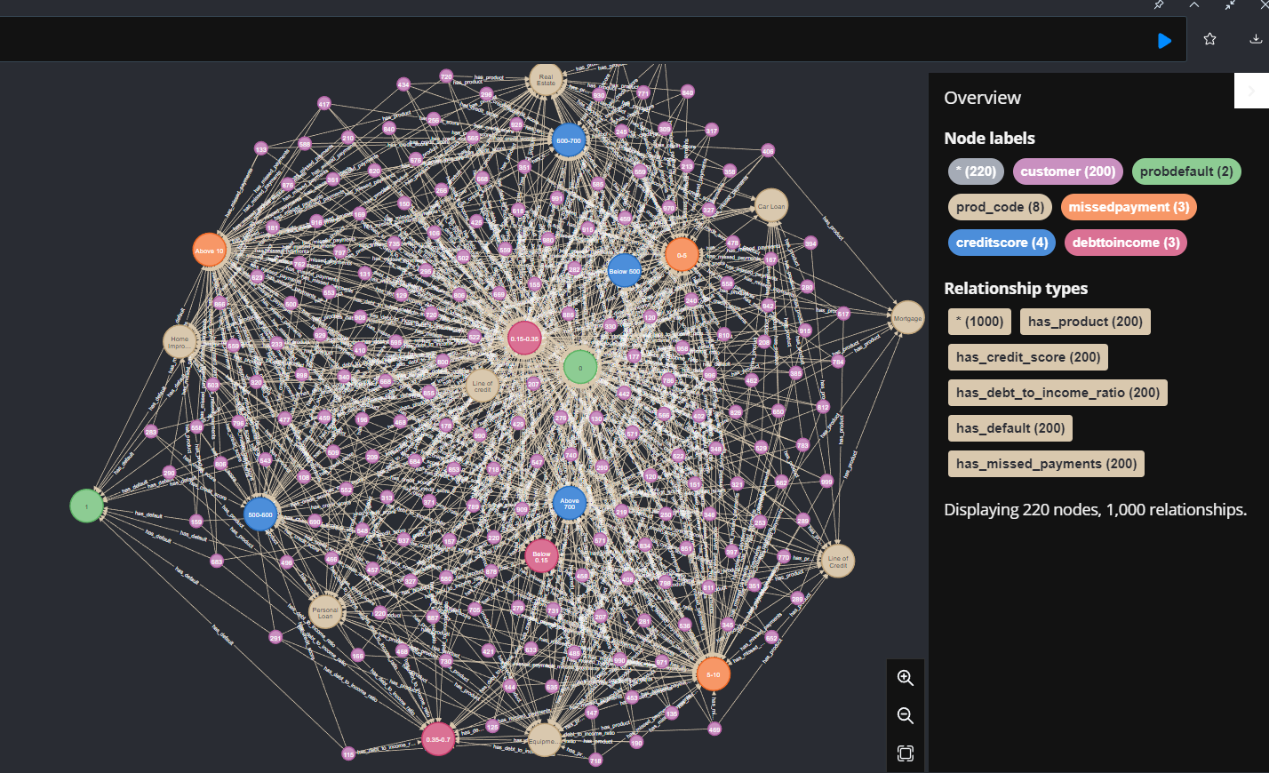

Slide 7
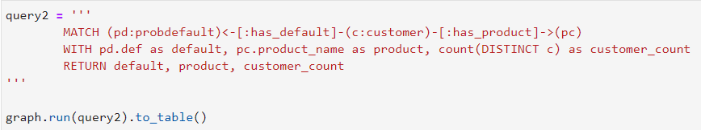
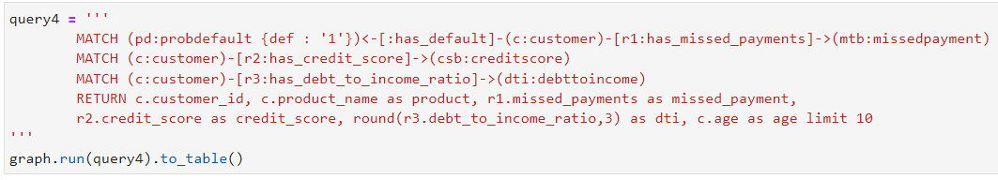
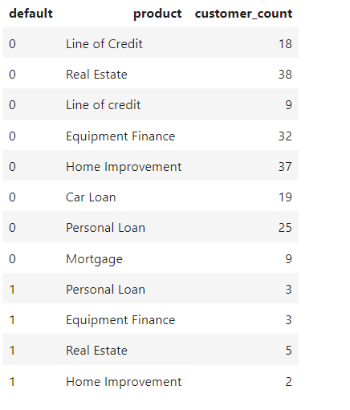
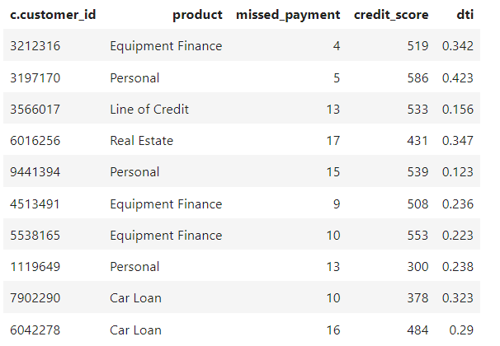
Insights from the graph

Slide 8
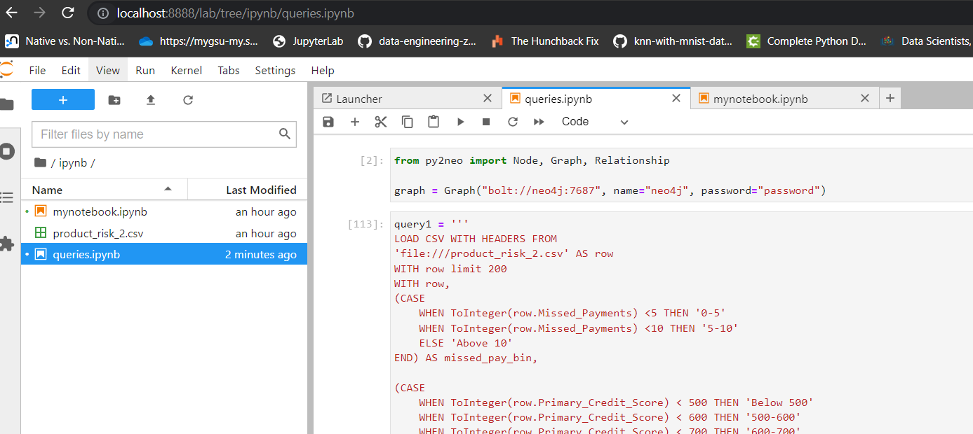
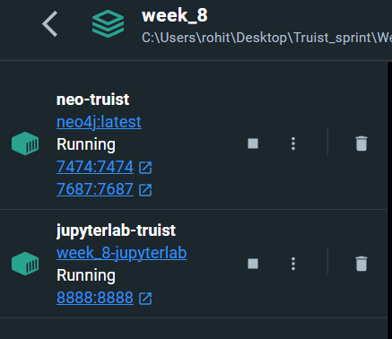
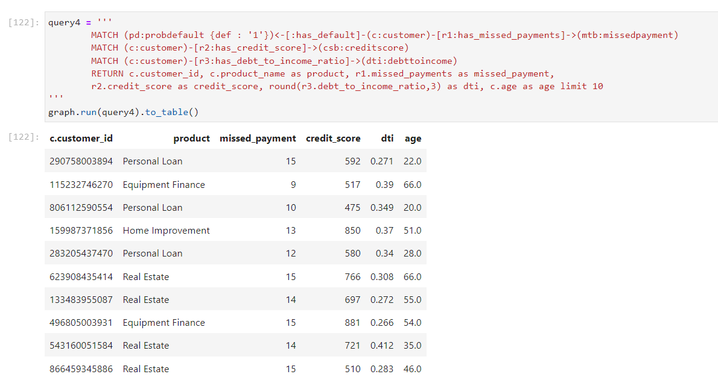
Docker
Docker Compose
Dockerfile

Slide 9
Questions ?

Slide 10
Thank you

